Slide 1

Termination and Reversion of Copyright Grants under U.S. Law

Slide 2
1976 Copyright Act –Termination Rights
1976 US Copyright Act provides authors and their heirs statutory right to terminate any copyright grant.
Different provisions for pre-’78 and post-’78 works.
For post-1978 grants - 35-40 yrs. after publication; or 40-45 years after grant if earlier
For pre-1978 works - 56-61 yrs. after grant.
Whether the grantee is currently exploiting work not relevant.

Slide 3
Termination Right Purpose
Provides authors with a second chance to market/monetize their works and recapture rights in the face of possible lopsided/inequal bargaining power of authors at time grant made.
But you have to wait many decades!
Older authors and heirs benefit from enduring works.
Author/heirs may negotiate a new license with original licensee with payment of new advance or higher royalties.
Or can self-publish or sell rights to others.

Slide 4
Statutory Provisions – Pre-’78 Works
§304(c): Covers grants made before January 1, 1978 in copyrights subsisting as 1978.
Termination Date between 56-61 years after grant.
Last terminations – for 1977 works in 2033 - 2038.
§ 304 (d)—Pre-1978 grants where the copyright in the work secured between January 1, 1923, and October 26, 1939.
Added when copyright terms extended to life plus 70.
Last day to terminate was October 26, 2019.

Slide 5
Statutory Provisions – Post ‘78 Works
§203 – Grants executed by author on or after January 1, 1978.
If grant covers publication of the work, 35-40 years from publication date or 40-45 years from the date of execution of the grant, whichever earlier.
Example:
Book publishing agreement executed in 1988 and book is published in 1990: Grant can be terminated during five-year period starting in 2025 (35 years from publication)
Same agreement but book published in 1994: Grant can be terminated in five-year period starting in 2024 (40 years from grant)
For grants that don’t include publication: 35 and 40 years after grant made.

Slide 6
Who can terminate?
Living author(s)
Multiple authors – majority of authors who executed the grant where grant executed by two or more authors.
Scorpio Music, S.A. v. Willis: termination notice only requires the signature of the authors who executed the grant, not all joint authors of original work.
Majority Statutory heirs of author (identified in statute):
Widow or widower, if surviving, take half.
Surviving children or grandchildren of author share other half on a per stripes basis.
If no heirs, then estate, trustee, etc.
Need majority (more than 50%) of heirs to sign termination notice.

Slide 7
PRH v. Steinbeck, 2nd Cir. 2008
Decision: 1994 agreement between Elaine Steinbeck and Penguin Group superseded original 1938 assignment, preventing the author's heirs from exercising statutory right to terminate earlier grant.
John Steinbeck willed copyrights to third wife Elaine. In 1983 Elaine and Steinbeck’s sons executed agreement that gave sons royalties and acknowledged their termination rights.
In 1994 Elaine entered into a new agreement with PRH that replaced the initial agreement. Died in 2003, bequeathing rights to daughter from earlier marriage.
In 2004, Sons tried to terminate 1938 grant, but PRH rejected it on grounds the 1938 agreement was terminated and replaced with the 1994 agreement.
Second Circuit said intent of parties in 1983 agreement does not matter; 1938 agreement no longer in effect; can’t be terminated.
2019 case Kaffaga v. Steinbeck Estate: 9th Circuit agrees that 1994 agreement not an agreement to contrary and heirs have no rights.

Slide 8
Cher v. Bono (2024)
Marriage Settlement Agreement (MSA) entered into by Sonny Bono and Cher in 1978 gave Cher a 50% interest in recording and composition royalties for copyrights in songs the owned before separation.
Sonny died in 1998. In 2016, Sonny’s second wife Mary Bono issued notices of termination to publishers for musical works Sonny composed. Notices did not mention the MSA. Mary stopped paying Cher her 50% share.
Cher sued for declaratory judgment that termination did not usurp MSA.
Court held that Mary Sono breached MSA by failing to pay royalties.
MSA is not an “agreement to the contrary” because it does not refer to termination of copyright grants. Right to receive royalties is distinct from a grant of copyright.

Slide 9
§203 - What cannot be Terminated
Derivative Works (e.g., film based on book, music or photo licensed for motion picture):
If created under the grant before termination can continue to exploit,
Works Made for Hire
Used by many companies to try to deny terminations.
Led to many disputes and litigations

Slide 10
Works Made for Hire
Under 1976 Act (for post-78 contracts/works):
Works made by employee within scope of employment; or
Commissioned with contract stipulating it is work made for hire and the work is among one of nine categories (includes motion picture, educational texts, and contributions to collective works).
Under 1909 Act (for pre-78 contracts/works):
Instance and Expense Test (1909 Act): Presumptive author and copyright holder of a commissioned work created by independent contractors is the commissioning party at whose instance and expense the work was done.

Slide 11
Work for Hire Termination Cases
Most disputes settled.
Sample litigated cases:
Marvel Characters v. Simon (2002)
Marvel Worldwide, Inc. v. Kirby (2013)
Ennio Morricone Music Inc. v. Bixio Music Group Ltd. (2019)
Lil' Joe Recs., Inc. v. Ross, 752 F. Supp. 3d 1287 (2024)

Slide 12
The Effect of Termination
On effective date of termination, rights covered by the terminated grant revert to the author(s) and heirs.
All who terminated jointly own the rights based on percentages of termination rights.
New grants must be signed by the same number and proportion of owners in whom rights vested.
New grants cannot be made until after the effective date of termination
Except to the original grantee (or successor), in which case new grant cannot be made until after termination notice served

Slide 13
Termination Notice Required and Window
Not less than two or more than ten years before the effective date of termination.
Example:
Book published in 1995, per contract signed in 1994, so termination window is 2030-2035.
Author choses Jan. 1, 2030 effective termination date.
Termination Notice Window: January 1, 2020 – January 1, 2028.

Slide 14
Notice Requirements and Pitfalls
Notice must be recorded in the Copyright Office before the effective date of termination, as a condition to taking effect.
Notice must comply with the Copyright Office’s regulations.
Failure to follow the formalities will result in author not recapturing rights.
Failure to do math correctly and identify effective date of termination in correct window or to serve notice within the allowed notice window will void termination.
Failure to comply with the CO’s notice requirements may void termination.

Slide 15
Copyright Office Requirements
Must submit a true, correct, complete, and legible copy of the signed notice of termination as served on the grantee or successor-in-title.
Accompanied by a statement of the date of termination notice and manner of service (unless information in the notice).
Filing fee
Notice of Termination cover sheet – covers required information

Slide 16
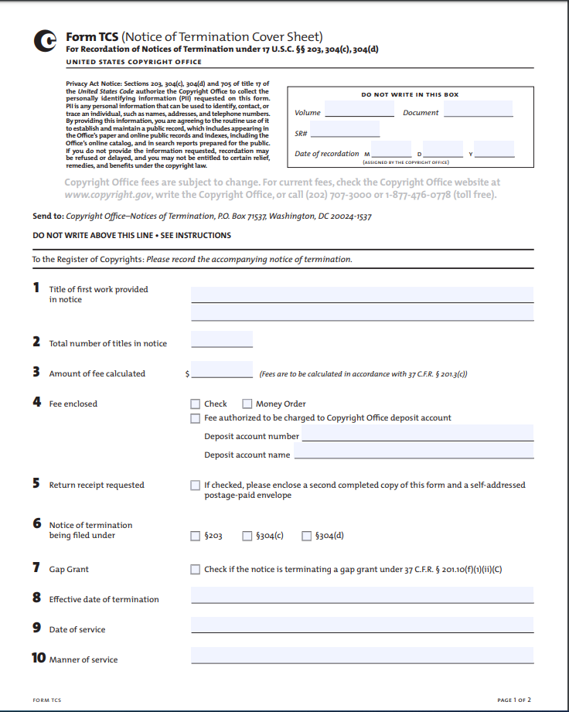
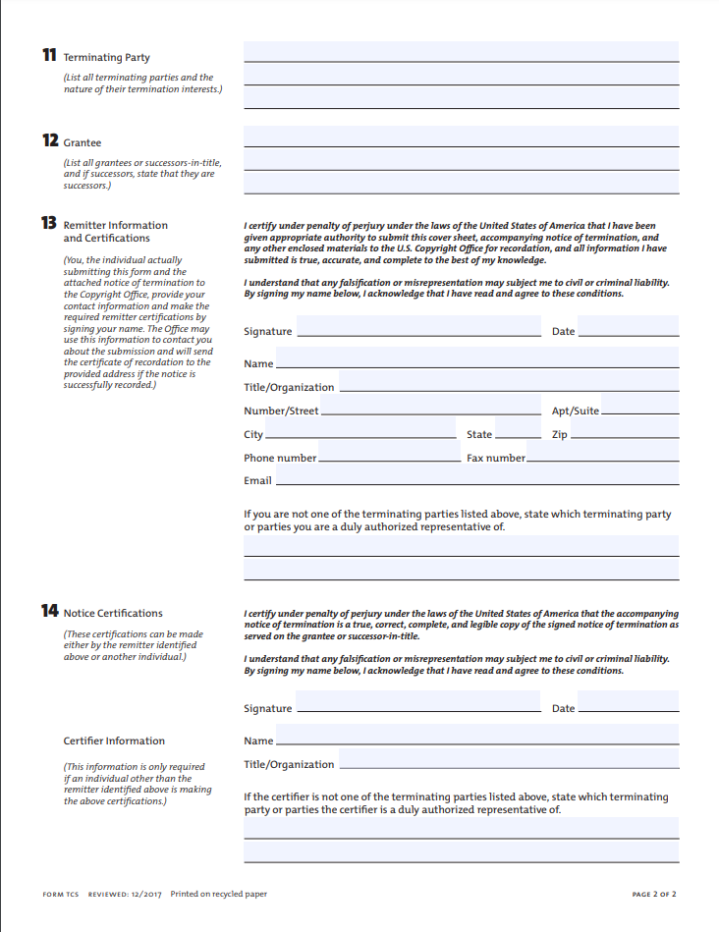
Pg. 1

Slide 17
Foreign Rights Grants
Many grants made for worldwide rights.
Until a recent case, it was considered the law that if a grant includes foreign rights, those rights could not be terminated but only US rights.
Vetter v. Resnik: District (lower) court recently decided that terminated rights under Section 304 extend to foreign rights as well as U.S. rights where the original grant was made for “worldwide” rights.
Currently on appeal: Briefs filed in 5th circuit last spring/summer; hearing next month.

Slide 18
Contractual Rights Prevail in U.S.
U.S. law gives priority to “freedom to contract” and relies on myth that all parties to a contract have bargaining power.
Exception for employees who have collective bargaining.
Film industry creators have collective bargaining agreements.
In some industries, contract norms provide creators with the ability to terminate grant and reclaim rights if work no longer exploited.
Contracts may also provide that rights revert if the work or is not exploited within a certain period of time.

Slide 19
Book Publishing Examples
Reversion rights: standard trade agreements allow author to reclaim rights if book goes “out of print” more than 2-3 years after initial publication:
Author often must send notice
Publisher often has a period of time, such as 6 months, to republish the book
“Out of print” usually defined as when royalties fall below a certain amount
Can sometimes get audio and foreign rights back if not used within a certain period of time after print publication.
New alternative types of publishing companies that compete with self-publishing: exclusive licenses are for limited terms of just 5-9 years, licenses are non-exclusive; or terminable on notice.

Slide 20
Other Industries
News, magazines and anthologies: Contracts sometimes specify that a grant becomes non-exclusive after a set period of time (6 months, 1-2 years); some news outlets take all rights in perpetuity.
Visual arts: Fine artists generally retain copyright; graphic design and other commercial art contracts vary from outright assignment, to termed or perpetual licenses, and sometimes where rights not used revert.
Recording industry and music publishing: difficult to get rights back; hence the practice of remastering and buying back publishing rights.
Film and TV: Contracts treat all creators as employees/works as works made for hire, so creator not deemed author in first place.
Collective bargaining agreements provide residual rights.

Slide 21
AG 2018 Plus Legislative Proposal
Early Copyright Termination for Out-of-Commerce Works
Premise: CR law should incentive publication/making works available and disincentivize those who hold onto rights and lock them up.
Proposal: Amend Section 203 to allow authors to terminate grants after ten years if the assignee/licensee has not commercially exploited the work in any meaningful way in the last 12 months.
Authors would provide notice of intent to terminate,
Publisher must respond within X months with agreement to terminate or evidence that it continues to sell the work; failure to respond results in grant being terminated.

Slide 22
Takeaways for Authors
Hold onto whatever rights you can: don’t grant exclusive perpetual rights in first place if possible.
Think about long term before you sign that contract.
Need to rethink industry standards:
Publishers and other licensees need to be fairly compensated for investment
But rights do not need to be tied up needlessly
Authors should be able to maximize exploitation by divvying up and licensing out different rights

